Slide 1
OPERATING SYSTEMS Topic :Scheduling Algorithms
PRESENTED BY:
K.KEERTHI PRIYA – 18B01A1261

Slide 2
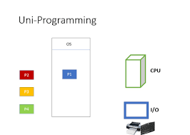
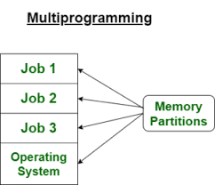
Why do we need scheduling?
A typical process involves both I/O time and CPU time. In a uni programming system like MS-DOS, time spent waiting for I/O is wasted and CPU is free during this time. In multi programming systems, one process can use CPU while another is waiting for I/O. This is possible only with process scheduling.

Slide 3
While considering the best scheduling algorithm the different criteria to check are:
1. CPU Utilization
2. Throughput
3. Turnaround Time
4. Waiting Time
5. Load Average
6. Response Time

Slide 4
Objectives of Process Scheduling Algorithm:
Max CPU allocation
Fair allocation of CPU
Max throughput
Min turnaround time
Min waiting time
Min response time

Slide 5
Different Scheduling Algorithms:
1. First Come First Serve (FCFS)
2. Shortest Job First (SJF)
3. Round Robin Scheduling
4. Priority Based Scheduling
5. Multiple-Level Queues Scheduling
6. Shortest Remaining Job First(SRJF)

Slide 6
First Come First Serve (FCFS):
It is an operating system scheduling algorithm that automatically
executes queued requests and processes in order of their arrival.
Characteristics of FCFS method
It supports non-preemptive and pre-emptive scheduling algorithm.
Jobs are always executed on a first-come, first-serve basis.
It is easy to implement and use.
This method is poor in performance, and the general wait time is quite high.

Slide 7
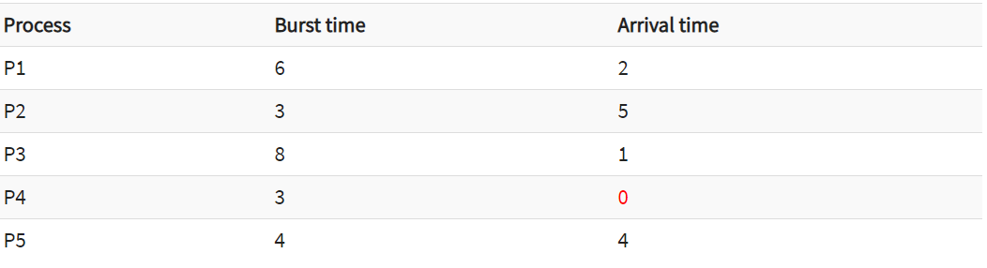
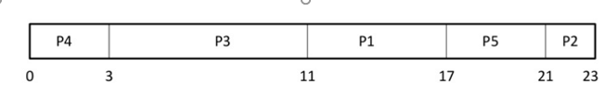
Example:

Slide 8
Waiting time:
Process | Waiting time
P1 | 11-2 = 9
P2 | 21-5= 16
P3 | 3-1 = 2
P4 | 0-0 = 0
P5 | 17-4 = 13
Average waiting time=(9+16+2+0+13)/5 = 40/5 = 8

Slide 9
Advantages of FCFS
The simplest form of a CPU scheduling algorithm
Easy to program
First come first served
Disadvantages of FCFS
It is a Non-Preemptive CPU scheduling algorithm
The Average Waiting Time is high.
Because of its simplicity, FCFS is not very efficient.

Slide 10
Shortest Job First(SJF):
Shortest Job First (SJF) is an algorithm in which the process having the smallest execution time is chosen for the next execution.
There are basically two types of SJF methods:
1. Non-Preemptive SJF
2 .Preemptive SJF

Slide 11
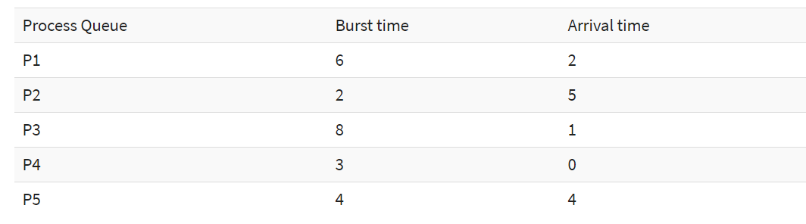
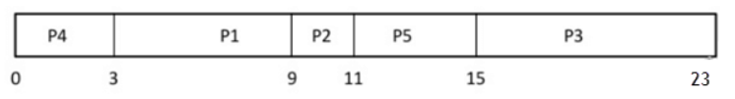
Non-Preemptive SJF:
In non-preemptive scheduling, once the CPU cycle is allocated to process, the process holds it till it reaches a waiting state or terminated.
Ex:

Slide 12
Preemptive SJF:
In Preemptive SJF Scheduling, jobs are put into the ready queue as they come.
Although a process with short burst time begins, the current process is removed or preempted from execution, and the job which is shorter is executed 1st.
SJF is frequently used for long term scheduling.

Slide 13
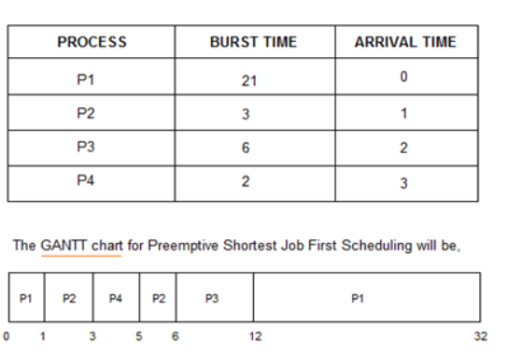
Ex:

Slide 14
Advantages of SJF
SJF is frequently used for long term scheduling.
It reduces the average waiting time over FIFO (First in First Out) algorithm.
SJF method gives the lowest average waiting time for a specific set of processes.
Disadvantages of SJF:
Job completion time must be known earlier, but it is hard to predict.
It is often used in a batch system for long term scheduling.
This algorithm may cause very long turnaround times or starvation.

Slide 15
Thank you

